Slide 1
Theory-Aided Model Checking of Concurrent Transition Systems
Guy Katz, Clark Barrett, David Harel
Weizmann Institute of Science
New York University

Slide 2


Compositional Verification
A divide and conquer verification approach
No need to explore all composite states
$$P$$
$$⊨$$
$$φ$$
$P_{1}$
$P_{2}$
$P_{3}$
$$⊨$$
$$φ_{1}$$
$$⊨$$
$$φ_{2}$$
$$⊨$$
$$φ_{3}$$

Slide 3
The Difficulties
Automation
Partition the system into modules
Choose “good” module properties
Prove module properties
Prove global property
A very difficult problem!

Slide 4
Our Approach
Trade generality for effectiveness
Do well on specific classes of programs
We present a fully automatic, compositional approach
Handle concurrent programs written in the RWB model
Based on SMT solving

Slide 5
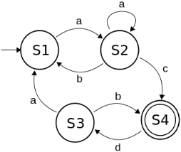
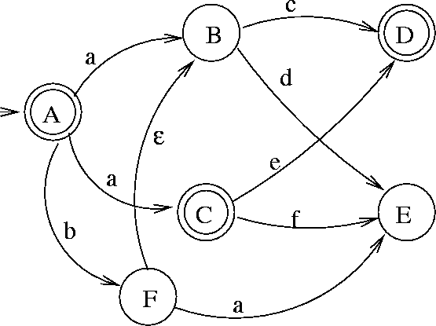
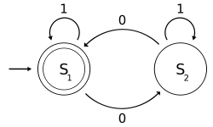
An SMT-Driven Process
Input program $s$
SMT
Solver
SAT (unsafe)
or
UNSAT (safe)
Assertion: $¬safe(s)$
Arithmetic
Transition Systems
Arrays
Transition Systems

Slide 6
A Theory of Transition Systems
Decision procedure: state space traversal
Look for known patterns in the input
Generate lemmas for other theory solvers
Lemmas allow other theories to aid in the verification
Prune the search space
Can significantly reduce verification time

Slide 7
Agenda
RWB Transition Systems
A Theory of Transition Systems
Programs with Shared Arrays
Periodic Programs
Experimental Results

Slide 8
Agenda
RWB Transition Systems
A Theory of Transition Systems
Programs with Shared Arrays
Periodic Programs
Experimental Results

Slide 9
Request / Wait / Block (RWB)
RWB programs have events and threads
Threads synchronize and declare
Requested events
Waited-for events
Blocked events
Trigger an event that is requested and not blocked
Inform threads that requested / waited-for the event

Slide 10
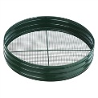
The Execution Cycle
Wait
B-s
Threads
Request
Block

Slide 11



Toy Example
$L={(0}^{5}⋅(0+{1))}^{ω}$
$1$ requested and not blocked at rightmost states
Precisely every 6 steps
$$0, 1$$
Trace: $00$
Trace: $0$
Trace:
Trace: $000$
Trace: $0000$
Trace: $00000$
Trace: $00000(0+1)$
$$0$$
$$R=0$$
$$B=1$$
$$R=0, 1$$
$$0, 1$$
$$0$$
$$0$$
$$R=0$$
$$B=1$$
$$R=0$$
$$B=1$$
$$R=0, 1$$

Slide 12
Why RWB?
RWB idioms are common
Publish / Subscribe systems
Supervisory control
Live Sequence Charts (LSCs)
Behavioral Programming
The strict synchronization mechanism facilitates reasoning about individual threads
Makes finding module properties easier

Slide 13
Agenda
RWB Transition Systems
A Theory of Transition Systems
Programs with Shared Arrays
Periodic Programs
Experimental Results

Slide 14
The Transition System (TS) Solver
Input:
Formulas describing RWB threads
An assertion that the program is unsafe
A deadlock state is reachable
Safety reducible to deadlock freedom
Output:
SAT if the property is violated (+ counter-example)
UNSAT if the property holds

Slide 15
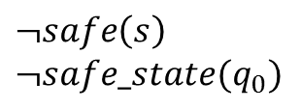
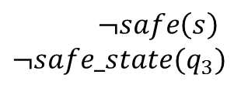
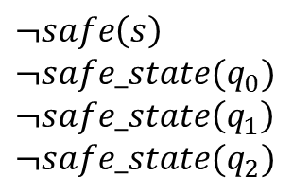
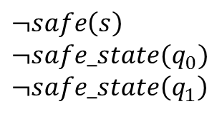
Basic Decision Procedure
$$¬safe(s)$$
$$q_{0}$$
$$q_{0}$$
Start
$$¬safe\left(s\right) \\ ¬safe_state(q_{0})$$
$$q_{3}$$
$$q_{1}$$
$$q_{3}$$
$$q_{1}$$
Decide
Decide
$$¬safe\left(s\right) \\ ¬safe_state(q_{0}) \\ ¬safe_state\left(q_{1}\right)$$
$$¬safe\left(s\right) \\ ¬safe_state(q_{3})$$
$$q_{2}$$
$$q_{2}$$
Decide
SAT
$$¬safe\left(s\right) \\ ¬safe_state(q_{0}) \\ ¬safe_state\left(q_{1}\right) \\ ¬safe_state(q_{2})$$
Theory-valid lemmas:
$$¬deadlock(q_{0})$$
Unsat
$$¬deadlock(q_{1})$$
$$¬deadlock(q_{2})$$
$$⊥$$

Slide 16
Pattern Matching
During state space traversal, TS looks for thread patterns
Structural properties of threads
Checked on each thread separately (compositionally)
When a pattern applies, lemmas are generated
From the languages of other theory solvers
The SMT core handles the interfaces
Other solvers can then curtail the search space

Slide 17


Pattern Matching: Example
$L={(0}^{5}⋅{(0+1))}^{ω}$
Property: never $1$
7 composite states
$$0, 1$$
$$0$$
$$R=0$$
$$B=1$$
$$R=0, 1$$
$$0, 1$$
$$0$$
$$0$$
$$R=0$$
$$B=1$$
$$R=0$$
$$B=1$$
$$R=0, 1$$
$$1$$
$$B=0, 1$$

Slide 18

Looped Threads
Looped thread: Step index determines state
Recognizing looped threads: Every state has $1$ successor
Also looped
$$0, 1$$
$$0$$
$$R=0$$
$$B=1$$
$$R=0, 1$$
$$0, 1$$
$$0$$
$$0$$
$$R=0$$
$$B=1$$
$$R=0$$
$$B=1$$
$$R=0, 1$$

Slide 19

Generating Lemmas
Where can $1$ be triggered?
Only where it is not blocked
Generate the lemma: $¬safe_state\left(〈p_{1},q_{1}〉\right)⟺$ $¬safe_state\left({〈p}_{2},q_{3}〉\right)∧$ $∃t∈ℕ. t≡1\left(mod 2\right) ∧ t≡2(mod 3)$
$$0, 1$$
$$0, 1$$
$$p_{1}$$
$$p_{2}$$
$$p_{2}$$
$$q_{1}$$
$$q_{2}$$
$$q_{3}$$
$$q_{3}$$
$$0$$
$$0$$
$$0$$
$$R=0$$
$$B=1$$
$$R=0, 1$$
$$R=0$$
$$B=1$$
$$R=0$$
$$B=1$$
$$R=0, 1$$

Slide 20
Generating Lemmas (cnt’d)
This part of the lemma: $∃t∈ℕ. t≡1\left(mod 2\right) ∧ t≡2\left(mod 3\right)$ indicates that state $〈p_{2},q_{3}〉$ is reachable
The SMT core asserts it to the arithmetic solver
If no such $t$ exists, return UNSAT
State $〈p_{2},q_{3}〉$ is unreachable
Otherwise continue from state $〈p_{2},q_{3}〉$
Skip intermediate states

Slide 21
Implementing Pattern Matchers
Matchers implemented as C++ classes
Take the input transition systems, answer yes/no
If pattern holds, invoked every time a new state is visited
Get to generate lemmas
Internally, very flexible
Compute strongly connected components
Check when events are always blocked / never requested
Threads are small, so this is cheap
Restriction: don’t construct the composite state graph!

Slide 22
Limitations
The technique is useful only when a pattern applies
Can a few stored patterns apply to many programs?
Examples in next sections
Adding patterns is amortized over future applications
Portfolio approach: quickly recognize that no pattern matches

Slide 23
Agenda
RWB Transition Systems
A Theory of Transition Systems
Programs with Shared Arrays
Periodic Programs
Experimental Results

Slide 24
Shared Arrays in RWB
Locally, threads can use any construct
Arrays, lists, etc
Inter-thread shared arrays – only through RWB

Slide 25

Example: A Shared Bit
Read by simultaneously requesting $read\left(0\right), read(1)$
The “wrong” value will be blocked
Can generalize to arbitrary shared arrays
$$B=read(1)$$
$$s_{0}$$
$$write(1)$$
$$write(0)$$
$$s_{1}$$
$$B=read(0)$$

Slide 26
Leveraging Shared Arrays
Recognize shared arrays in the input threads
Extract arity, read / write events, initial value, etc
Sometimes it is used unintentionally
Check if violations occur only in certain configurations
Sometimes certain configurations are the violation
During state traversal, generate lemmas when a shared memory cell becomes fixed
Write events always blocked / never requested
The array theory solver can then curtail the search

Slide 27
Example: Tic Tac Toe
Goal: complete a row, column or diagonal
If no mistakes are made, game always ends in a draw
 |  | X
 |  | X
O
X
 |  | X
O
X
 |  | X
O | O
X
 |  | X
O | O | X
X
 | O | X
O | O | X
X |  | X
 | O | X
O | O | X
X |  | X
 | O | X
O | O | X

Slide 28
Implementing Tic Tac Toe
Program plays $O$, player plays $X$
Goal: never lose
Board modeled as a shared array with 3-valued elements
Rule threads, strategy threads
Blocking used to prevent multiple writes to each cell

Slide 29
Verifying Tic Tac Toe
Programmer: I’ve covered all cases in which $X$ wins by taking the upper row. Let’s test that!
A state is bad if $X$ has the upper row
A certain configuration of the array
Generate lemma: $¬safe\left(s\right)⇒board\left[0\right]=board\left[1\right]=board\left[2\right]= X$

Slide 30
Example
Board:
Decide: $X\left(1,1\right)$
Decide: $O\left(2,2\right)$
Decide: $X(0,0)$
Decide: $O\left(0,1\right)$
Array theory solver raises a conflict
Backtrack, without exploring successor states
 |  |  |  | $$X$$
$$O$$ |  |  |  | $$X$$
$$O$$ |  |  |  | $$X$$ |  |  |  | $$X$$
$$O$$ |  |  |  | $$X$$ |  |  | $$O$$ | $$X$$
 |  |  |  |  |  | $$X$$ | $$X$$ | $$X$$
$$¬safe_state\left(q_{1}\right)⇒board\left[4\right]=X$$
$$¬safe_state\left(q_{2}\right)⇒board\left[8\right]=O$$
$$¬safe_state\left(q_{3}\right)⇒board\left[0\right]=X$$
$$¬safe_state\left(q_{4}\right)⇒board\left[1\right]=O$$

Slide 31
Agenda
RWB Transition Systems
A Theory of Transition Systems
Programs with Shared Arrays
Periodic Programs
Experimental Results

Slide 32
Periodic Programs
Single processor scheduling problems
Each task has
period $P$
execution time $C$
priority (static/dynamic)
Programs have nice arithmetic properties

Slide 33
Periodic Programs in RWB
A task that needs to be scheduled requests an event
Priorities expressed by blocking less urgent tasks
Pattern matcher checks this on individual threads
Then generates arithmetic lemmas about time instances when a violation can occur

Slide 34
Example
TS Theory
Arithmetic Theory
$$x$$
$$x mod 5≥3$$
$$x mod 6≥3$$
$$x mod 11==0$$
$$x= 143$$
…, $x≠143$
$$x=513$$
…, $x≠513$
UNSAT, property holds

Slide 35
Agenda
RWB Transition Systems
A Theory of Transition Systems
Programs with Shared Arrays
Periodic Programs
Experimental Results

Slide 36
Experimental Results
Benchmarks: periodic programs and program with shared arrays
Average speedup: $63\%$

Slide 37

Experimental Results (cnt’d)
Larger example: a web-server
Average speedup: $16\%$

Slide 38
Conclusion
Automatic compositional verification of RWB programs
Added a theory of transition systems to CVC4
Traverse state space and look for patterns
When a pattern is found, generate lemmas
Other theories can then curtail the search space
Examples:
Programs with shared arrays
Periodic programs

Slide 39
Future Work
Support additional models beyond RWB
Add more patterns
Improve the portfolio approach

Slide 40
Questions
Thank You!

