Slide 1
Compositional Verification of Procedural Programs using Horn Clauses over Integers and Arrays
Anvesh Komuravelli
work done at Carnegie Mellon University
Joint work with Nikolaj Bjørner, Arie Gurfinkel, and Kenneth McMillan

Slide 2
In essence…
Efficiently under-approximating projections,
in presence of array quantifiers.

Slide 3
Why projections?
Image computation
Computing weakest preconditions (e.g., in IC3 style reasoning)
Computing must summaries for procedural programs
Notes:
In image computation, we need to quantify the current state variables to get…
For several practical reasons, we want to be able to eliminate these quantifiers.

Slide 4
But, Quantifier Elimination is expensive!
Model-based Projection (MBP)
Under-approximate the
Projection!
SAT assignments to x
Notes:
In all those scenarios, we can get away with under approximations
in particular, this talk is about a model-based approach that generalizes points to subsets. we call this model-based projection

Slide 5
MBP for Propositional Logic
(under-approximates)
u₁ 0
u₂ 1
x₁ 0
x₂ 0
x₃ 1
substitute 0/u₁, 1/u₂
Model
M
Notes:
let’s consider the case where the quantifiers are Boolean

Slide 6
MBP for Linear (Real) Arithmetic
Infinite space of models – Substitution Method does not work!
Loos-Weispfenning’s equivalence:
Pick a disjunct based on the model
Notes:
similar approach exists for Linear Integer Arithmetic

Slide 7
What if we have array variables?
Arrays are common for modeling heap memory
In presence of procedures, can’t get rid off them easily!
  Inlining procedure calls and (hopefully) lowering arrays to registers bloats the program size exponentially
  Recursive procedures cannot be inlined
MBP for the (extensional) theory of arrays?
Notes:
depending on the input program, you might be able to inline and get rid off arrays

Slide 8
Eliminating Array Quantifiers
Notes:
We’ll first look at what it means to eliminate array quantifiers and then look at MBP for arrays

Slide 9
Eliminating array quantifiers can introduce quantifiers of index/value sort!
(Ackermann Reduction)
Notes:
First of all, we should note that…

Slide 10
ArrayQE basically has 3 steps
Eliminate Writes
Eliminate (Partial) Equalities/Disequalities
Eliminate Reads (aka Ackermann Reduction)
(the result can have quantifiers of index/value sorts)

Slide 11
ArrayQE Example
Eliminate Writes
Notes:
<explain write notation>
the idea here is to eliminate read-after-writes and rewrite equalities/disequalities to the form a=<sth>

Slide 12
ArrayQE Example
Partial Equality
Eliminate Writes

Slide 13
ArrayQE Example
substitute
substitute
Eliminate Equalities
and Disequalities
Eliminate Writes
➔

Slide 14
ArrayQE Example
Eliminate Equalities
and Disequalities
Eliminate Writes
➔
➔
Eliminate Reads
Notes:
summarize the sequence of steps at the bottom of the slide

Slide 15
MBP for the Theory of Arrays
(ARR)

Slide 16
ArrayMBP amounts to picking disjuncts from ArrayQE
Eliminate Writes

Slide 17
ArrayMBP Example
Eliminate Writes

Slide 18
ArrayMBP Example
substitute
substitute
Eliminate Equalities
and Disequalities
Eliminate Writes
➔

Slide 19
ArrayMBP Example
Eliminate Equalities
and Disequalities
Eliminate Writes
➔
➔
Eliminate Reads

Slide 20
ArrayMBP Example
Eliminate Equalities
and Disequalities
Eliminate Writes
➔
➔
Eliminate Reads

Slide 21
MBP for the combination
LIA + ARR
Notes:
Assume that index and value sorts are integers

Slide 22
In 2 steps:
Eliminate array quantifiers using ArrayMBP (which can introduce integer quantifiers)
Eliminate integer quantifiers using MBP for LIA

Slide 23
Caveat: Integer quantifiers cannot always be eliminated!
has no equivalent quantifier-free formula!
Fall-back to the substitution method

Slide 24
Equality Resolution to avoid the Substitution Method

Slide 25
Ideas are implemented in our tool Spacer
IC3-style compositional reasoning for Procedural Programs
MBP for under-approximating weakest precondition
Two kinds of procedure summaries
May Summaries
Must Summaries
Over-approximate QE with
Interpolation
Under-approximate QE with
MBP
Notes:
The interaction between MBP for weakest precondition and interpolation introduces a new problem

Slide 26
Substitution method can lead to diverging interpolants!
Weakest Precondition
Under-approx
…
…
Notes:
suppose we know that at the previous step, a=b holds

Slide 27
Heuristically privilege array (dis-)equalities
Notes:
so, we speculatively “strengthen” with disequality

Slide 28
Experimental Evaluation

Slide 29
Compare Spacer with and without inlining
The SeaHorn front-end has an option to inline procedure calls
Inlining gets rid off most of the array variables, for Device Drivers category of SV-COMP’15.
(Spacer minus ArrayMBP) can only handle a small fraction of the non-inlined programs

Slide 30
Compare Spacer with and without inlining
lots of
time-outs

Slide 31
Conclusion
Model-based Projection (MBP) for the extensional theory of arrays
Quantifiers of index and value sort cannot always be eliminated
Heuristics to avoid the model substitution method
Practical advantage over SV-COMP’15 benchmarks
Adapt the ideas to obtain Quantified Invariants?

Slide 32
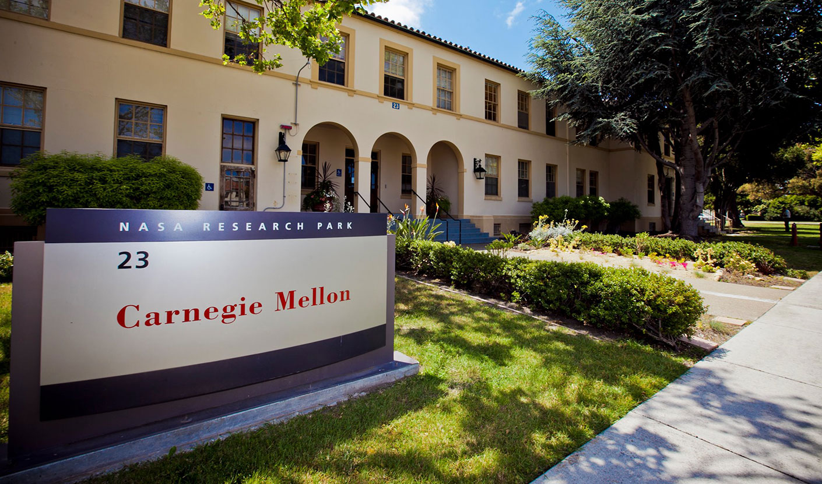
Available postdoctoral positions
What: development and application of SeaHorn
Where: CMU/NASA Silicon Valley Campus
Contact:
Temegshen Kahsai temesghen.kahsaiazene@nasa.gov
Arie Gurfinkel arie@cmu.edu

Slide 33
Questions?
Notes:
where is extensionality used?
how do you lower arrays to registers?
reviewer q&a

